Slide 1



Course : Machine Learning
Lecture On : Pre Assignment- NER
Instructor : Siddhesh Gunjal

Slide 2
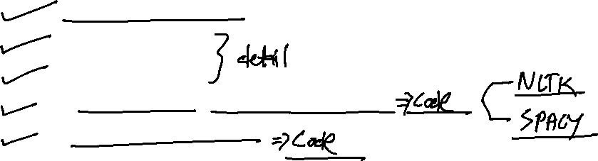
Agenda
1
Problem Statement
2
Sequence Tagging
3
NER
5
Pre-Trained and custom NER Demonstration
6
Starter-Code Walkthrough

Slide 3
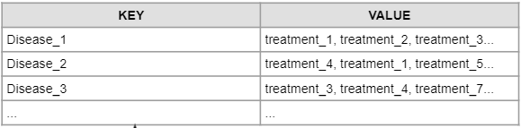
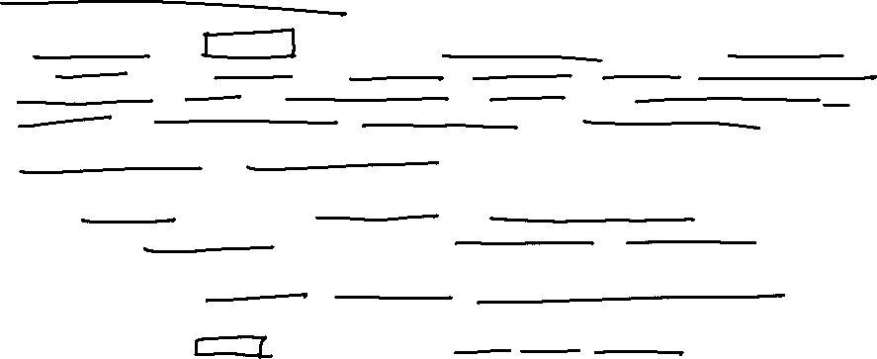
Problem Statement
A health-Tech company BeHealthy aims to connect the medical communities with millions of patients across the country it has a web platform that allows doctors to list their services and manage patient interactions and provides services for patients such as booking interactions with doctors and ordering medicines online. Here, doctors can easily organize appointments, track past medical records and provide e-prescriptions.
This organization generates a huge text data day by day
Example: “The patient was a 62-year-old man with squamous cell lung cancer, which was first successfully treated by a combination of radiation therapy and chemotherapy.”
Our task is to determine the disease name and its probable treatment from the dataset

Slide 4
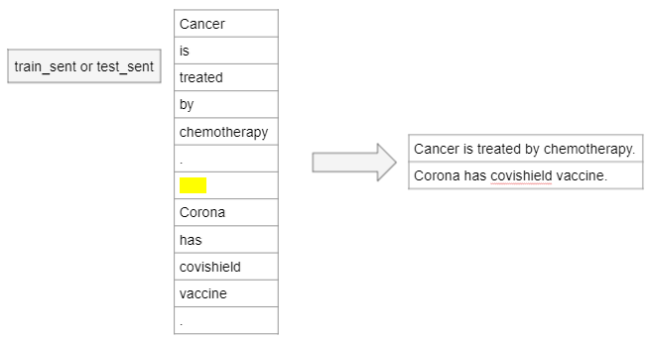
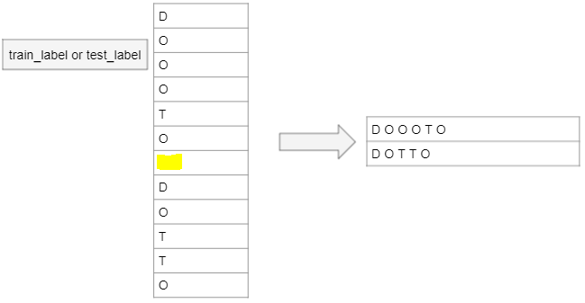
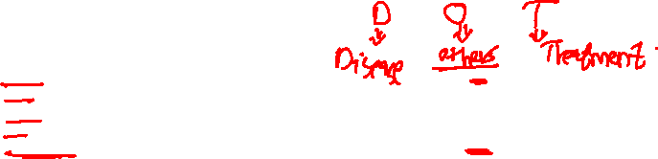
Problem Statement
Problem Statement : Build a custom NER to get the list of diseases and their treatment from the dataset and list it out in the form of a table or a dictionary

Slide 5
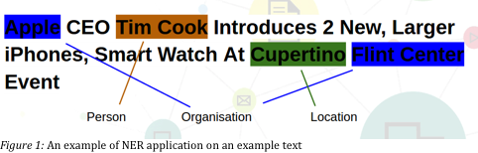
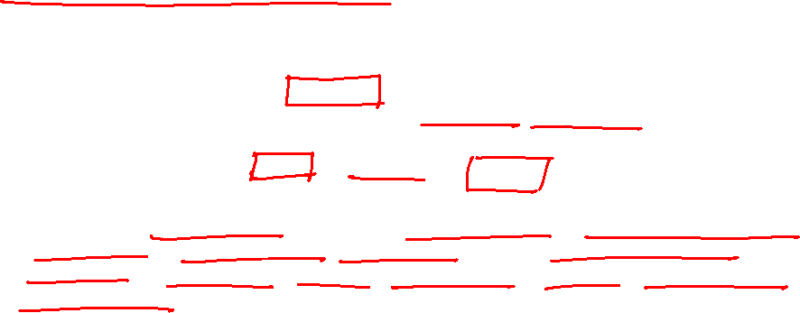
Named-Entity-Recognition (NER)
Named entity recognition (NER) is probably the first step towards information extraction that seeks to locate and classify named entities in text into pre-defined categories such as the names of persons, organizations, locations, expressions of times, quantities, monetary values, percentages, etc.
https://spacy.io/usage/linguistic-features#named-entities

Slide 6

Named-Entity-Recognition (NER)
Resumes Summarization
we could facilitate evaluation of resumes at a quick glance, thereby simplifying the effort required in shortlisting candidates among a pile of resumes.
Chatbot
Custom NER’s are used to extract information from users text to understand the requirement (NLU)
Search Engine
The key tags in the search query can then be compared with the tags associated with the website articles for a quick and efficient search.
Recommender Systems
NER can be used in developing algorithms for recommender systems which automatically filter relevant content we might be interested in and accordingly guide us to discover related contents

Slide 7
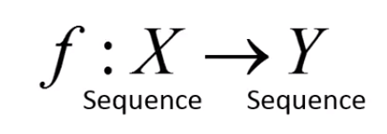
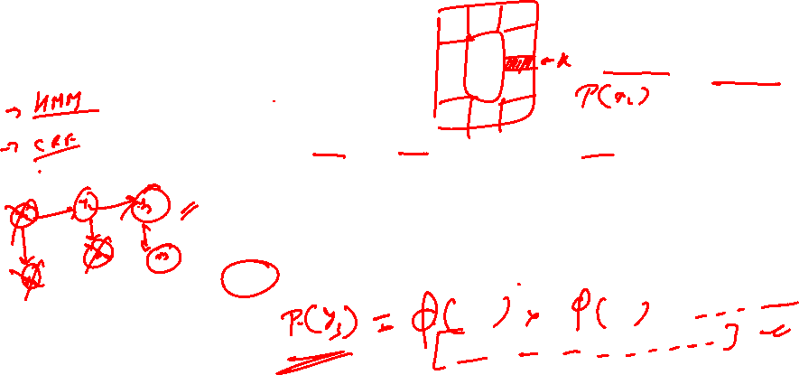
Sequence Tagging
Input: sequence of 𝑛 tokens (words)
Output: sequence of 𝑛 tags (labels)
X: x1 x2 x3 ….. Xn
Y: y1 y2 y3 ….. yn
(Token Sequence)
(Label Sequence)

Slide 8
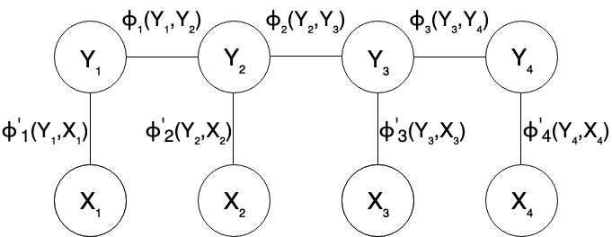
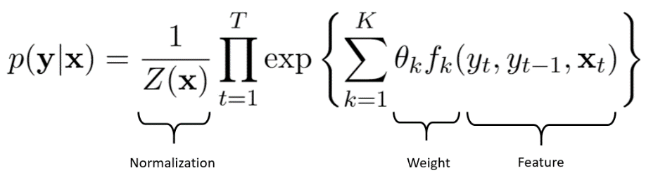
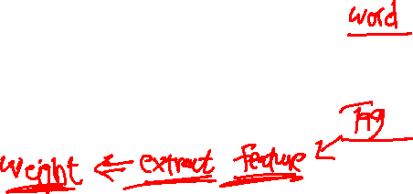
CRF
Conditional Random Field is a special case of Markov Random field Whereas a classifier predicts a label for a single sample without considering "neighboring" samples, a CRF can take context into account. To do so, the prediction is modeled as a graphical model.
which implements dependencies between the predictions. What kind of graph is used depends on the application.
For example, in NLP , linear chain CRFs are popular, which implement sequential dependencies in the predictions while In image processing the graph typically connects locations to nearby and/or similar locations to enforce that they receive similar predictions.
https://homepages.inf.ed.ac.uk/csutton/publications/crftut-fnt.pdf

Slide 9
Inside–outside–beginning (tagging)
In entity recognition, every token is tagged with an IOB label and then nearby tokens are combined together based on their labels.
The IOB format (short for inside, outside, beginning) is a common tagging format for tagging tokens in named-entity recognition
IOB labeling is especially helpful if the entities contain multiple words. We would want our system to read words like ‘Air India’, ‘New Delhi’, etc, as single entities
The B- prefix before a tag indicates that the tag is the beginning of a chunk.
The I- prefix before a tag indicates that the tag is inside a chunk
The O tag indicates that a token belongs to no chunk
Alex
is
going
to
Los
Angeles
B-PER
O
O
O
B-LOC
I-LOC
https://lingpipe-blog.com/2009/10/14/coding-chunkers-as-taggers-io-bio-bmewo-and-bmewo/

Slide 10
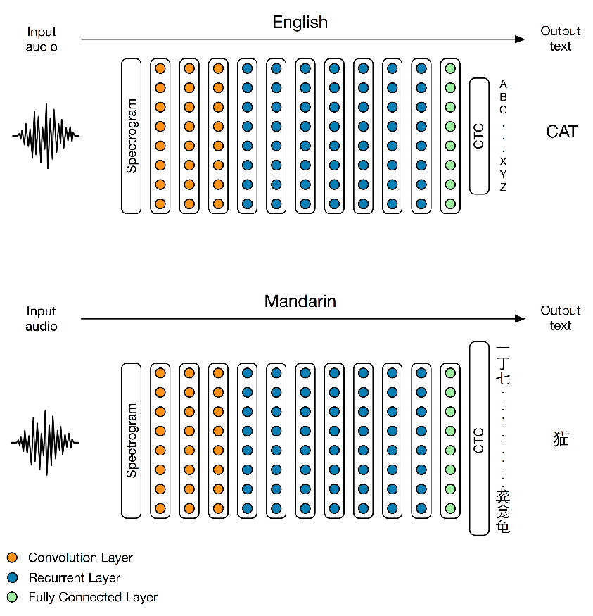
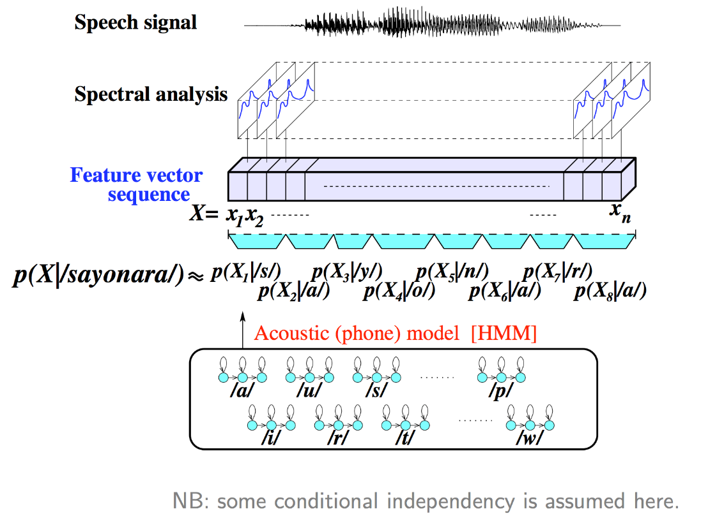
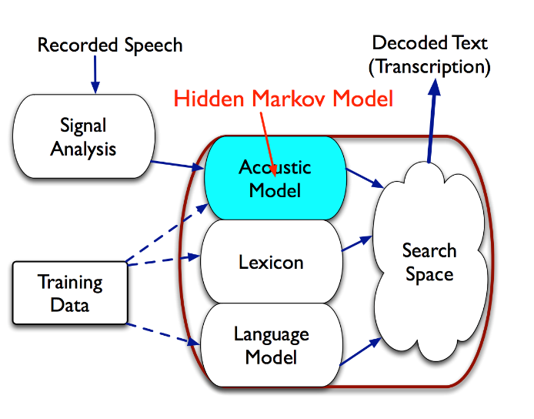
Speech Recognition

Slide 11
Thank You !

